Slide 1

Green Pace
Security Policy Presentation
Developer: Michael Cannon

Slide 2

OVERVIEW: DEFENSE IN DEPTH
Why is a security policy needed?
Provides security-first application development guidelines
Helps to Prevent security breaches
Defines encryption and data handling policies

Slide 3
THREATS MATRIX
Likely SQL Injection | Priority DDOS Attack
Low priority Assertion Testing | Unlikely Freed Memory Exceptions
Focus on Likely or Priority concerns
Low Priority and Unlikely items are internal code items
Automated tests assist with code issues

Slide 4
10 PRINCIPLES
Validate Input Data | STD-001-CPP | Test data types before performing type-specific operations
Heed Compiler Warnings | STD-005-CPP | Prevent access to memory beyond bounds of allocation.
Architect and Design for Security Policies | STD-008-CPP | Code that may throw exceptions must by in a try/catch block
Keep It Simple | STD-003-CPP | User input must always be gathered by a std::string
Default Deny | STD-008-CPP | Code that may throw exceptions must by in a try/catch block
Adhere to the Principle of Least Privilege | STD-007-CPP | Exceptions must be thrown when code execution cannot continue.
Sanitize Data Sent to Other Systems | STD-002-CPP | Expecting data values without testing can lead to unexpected results
Practice Defense in Depth | STD-004-CPP | Prevent SQL injection by sanitization of user inputs
Use Effective Quality Assurance Techniques | STD-006-CPP | Assertions should be used for proper debug testing, but code must work with assertions omitted.
Adopt a Secure Coding Standard | STD-002-CPP | Expecting data values without testing can lead to unexpected results

Slide 5
CODING STANDARDS
STD-001-CPP | Test data types before performing type-specific operations
STD-002-CPP | Expecting data values without testing can lead to unexpected results
STD-003-CPP | User input must always be gathered by a std::string
STD-004-CPP | Prevent SQL injection by sanitization of user inputs
STD-005-CPP | Prevent access to memory beyond bounds of allocation.
STD-006-CPP | Assertions should be used for proper debug testing, but code must work with assertions omitted.
STD-007-CPP | Exceptions must be thrown when code execution cannot continue.
STD-008-CPP | Code that may throw exceptions must by in a try/catch block
STD-009-CPP | Do not access freed memory or pointers
STD-010-CPP | Ensure that numeric functions do not overflow

Slide 6
ENCRYPTION POLICIES
Encryption at rest
Encryption in flight
Encryption in use

Slide 7
TRIPLE-A POLICIES
Authentication
Authorization
Accounting

Slide 8
Unit Testing
Tests for C++ vectors:
Can add to empty vector
Capacity is greater than size
Resizing increases collection
Resizing to Zero sets collection to zero
Reserving space increases capacity, not size

Slide 9
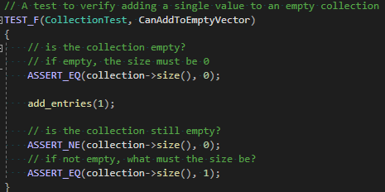
Can Add to Empty Vector
Verifies Entry and size change when indices are added

Slide 10
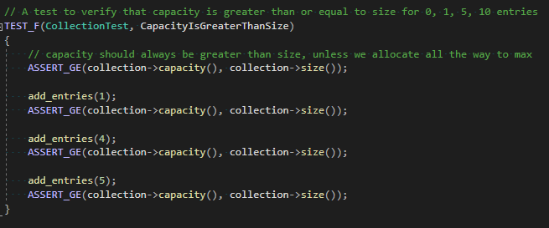
Capacity is greater than size
Verifies capacity of the vector is greater than size

Slide 11
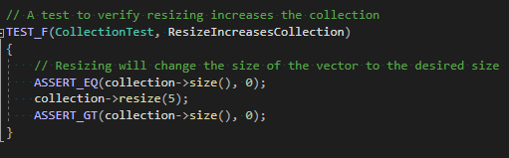
Resizing increases collection
Verifies resizing a vector increases the size

Slide 12
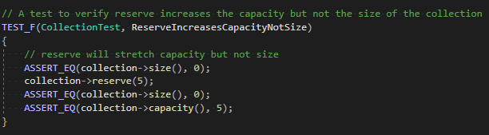
Reserve increases capacity, not size
Verifies reserving vector indices increases the capacity but does not change the size.

Slide 13

AUTOMATION SUMMARY

Slide 14
TOOLS
How does DevSecOps work?
Handles security like functionality
Adopts a security-first mindset
Automates testing alongside development
Tools for DevSecOps
Code analyzers
Server Logging
Unit Tests

Slide 15
RISKS AND BENEFITS
Why adopt this security policy now?
Couldn’t it wait?
How can it improve?

Slide 16
RECOMMENDATIONS
GDPR regulation expansion
User data protection choices
External policy adoption
Contractor penetration testing

Slide 17
CONCLUSIONS
Clarity
Purpose
Execution
Consistency
Creation
Documentation
Flexibility
Adaptation
Expansion

